Slide 1
Calculating the mean
Numerical summaries of data

Slide 2
how to use Oak lessons

Slide 3
I can calculate the mean from data presented in a frequency table and different graphs.

Slide 4
mean
measure of central tendency
data
frequency

Slide 5
The (arithmetic) mean for a set of numerical data is the sum of the values divided by the number of values. It is a measure of central tendency representing the average of the values.
A measure of central tendency is a summary measure that attempts to describe a whole set of data with a single value that represents the middle or centre of its distribution.
Data are a collection of information.
The frequency is the number of times an event occurs; or the number of individuals (people, animals etc.) with some specific property.

Slide 6

Calculating the mean
Calculating the mean from a line graph
Calculating the mean from an ungrouped frequency table
Calculating the mean from a bar chart

Slide 7
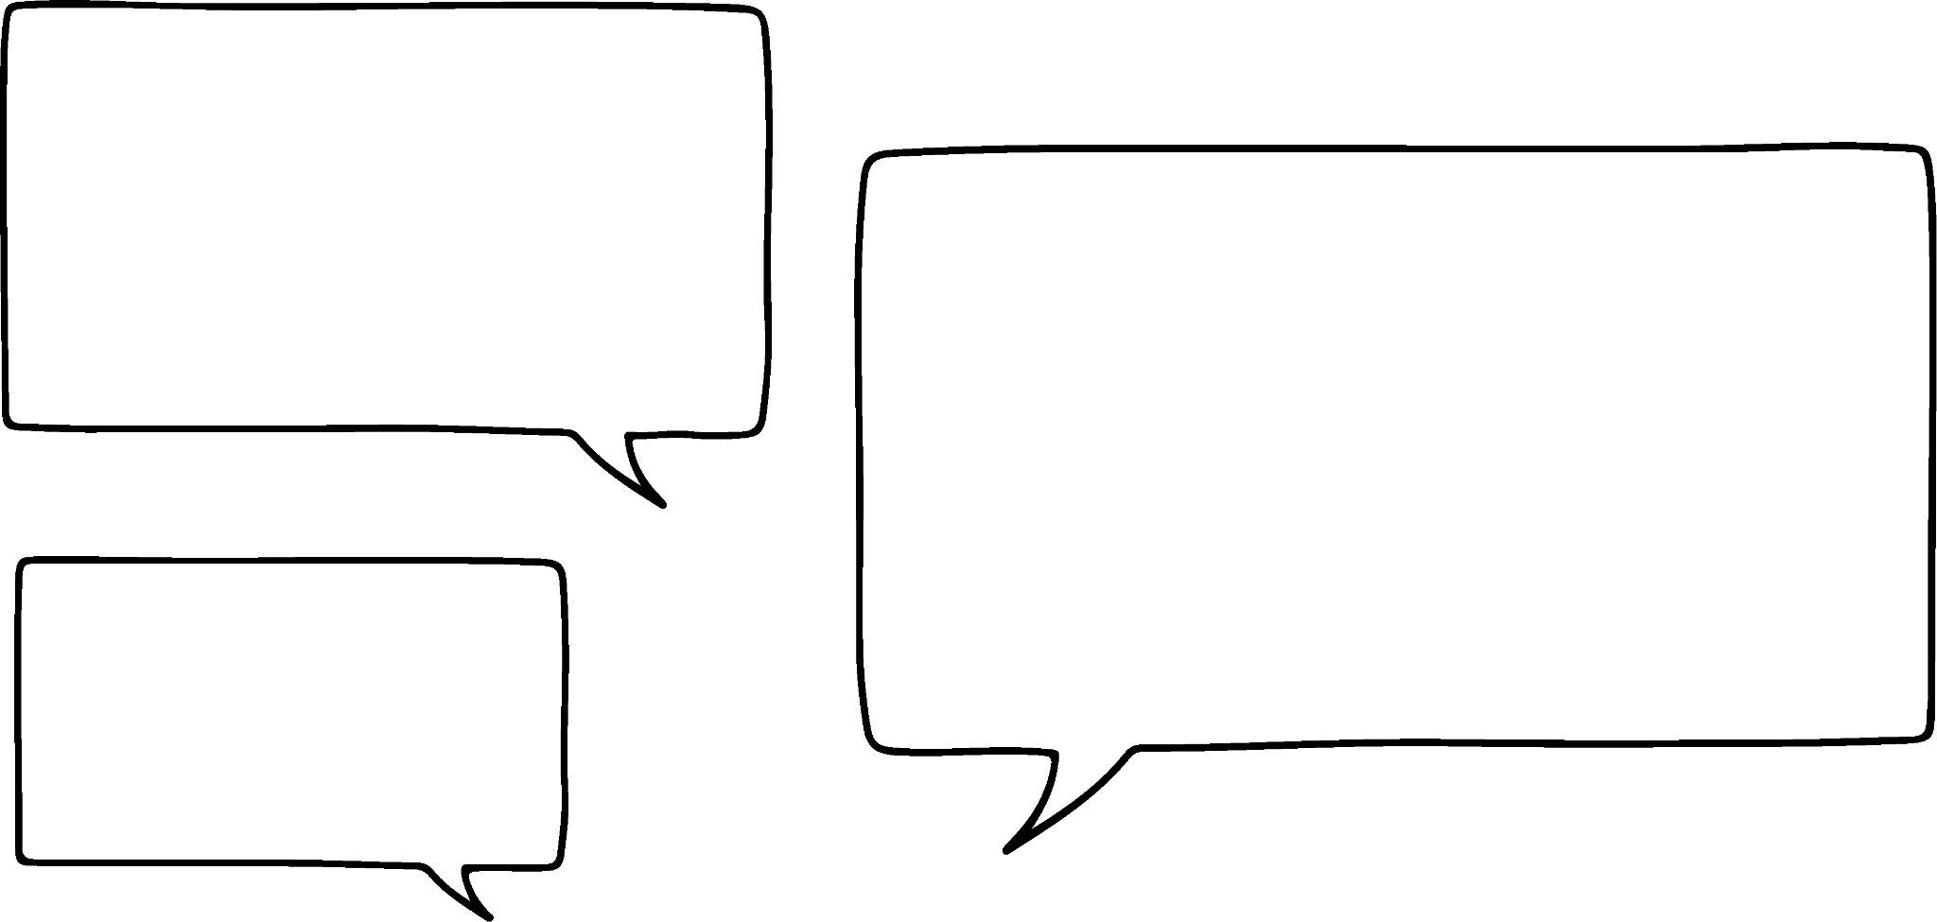
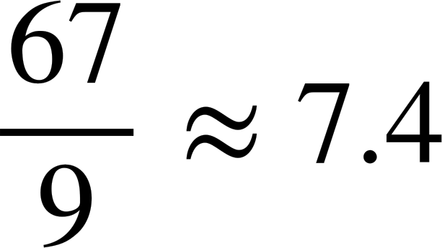
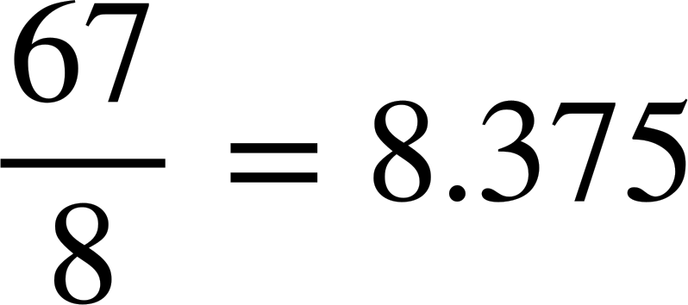


Calculating the mean from a line graph
Data has been collected about the number of days of frost in February over 9 different years.
Year | 1941 | 1951 | 1961 | 1971 | 1981 | 1991 | 2001 | 2011 | 2021
Number of days of frost | 13 | 2 | 0 | 3 | 12 | 16 | 11 | 1 | 9
The mean number of days of frost has been calculated by Aisha and Jacob.
Jacob is correct.
The 0 in 1961 is part of the data set.
Who is correct?

Slide 8
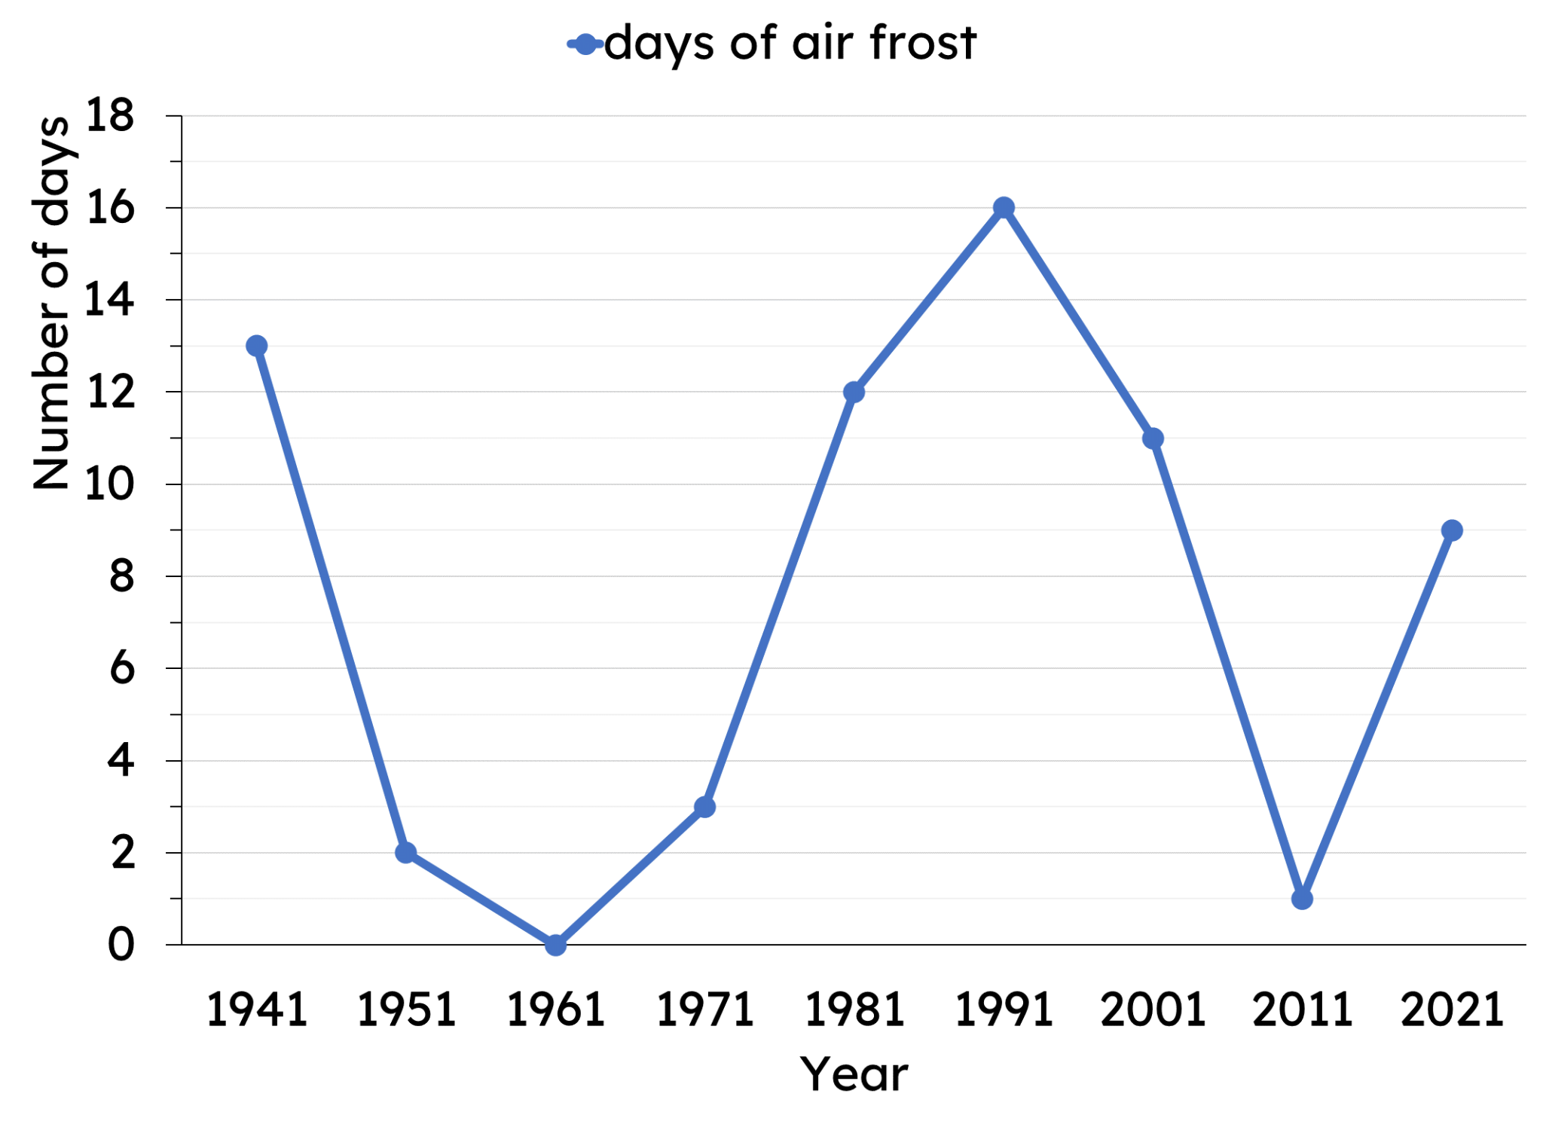
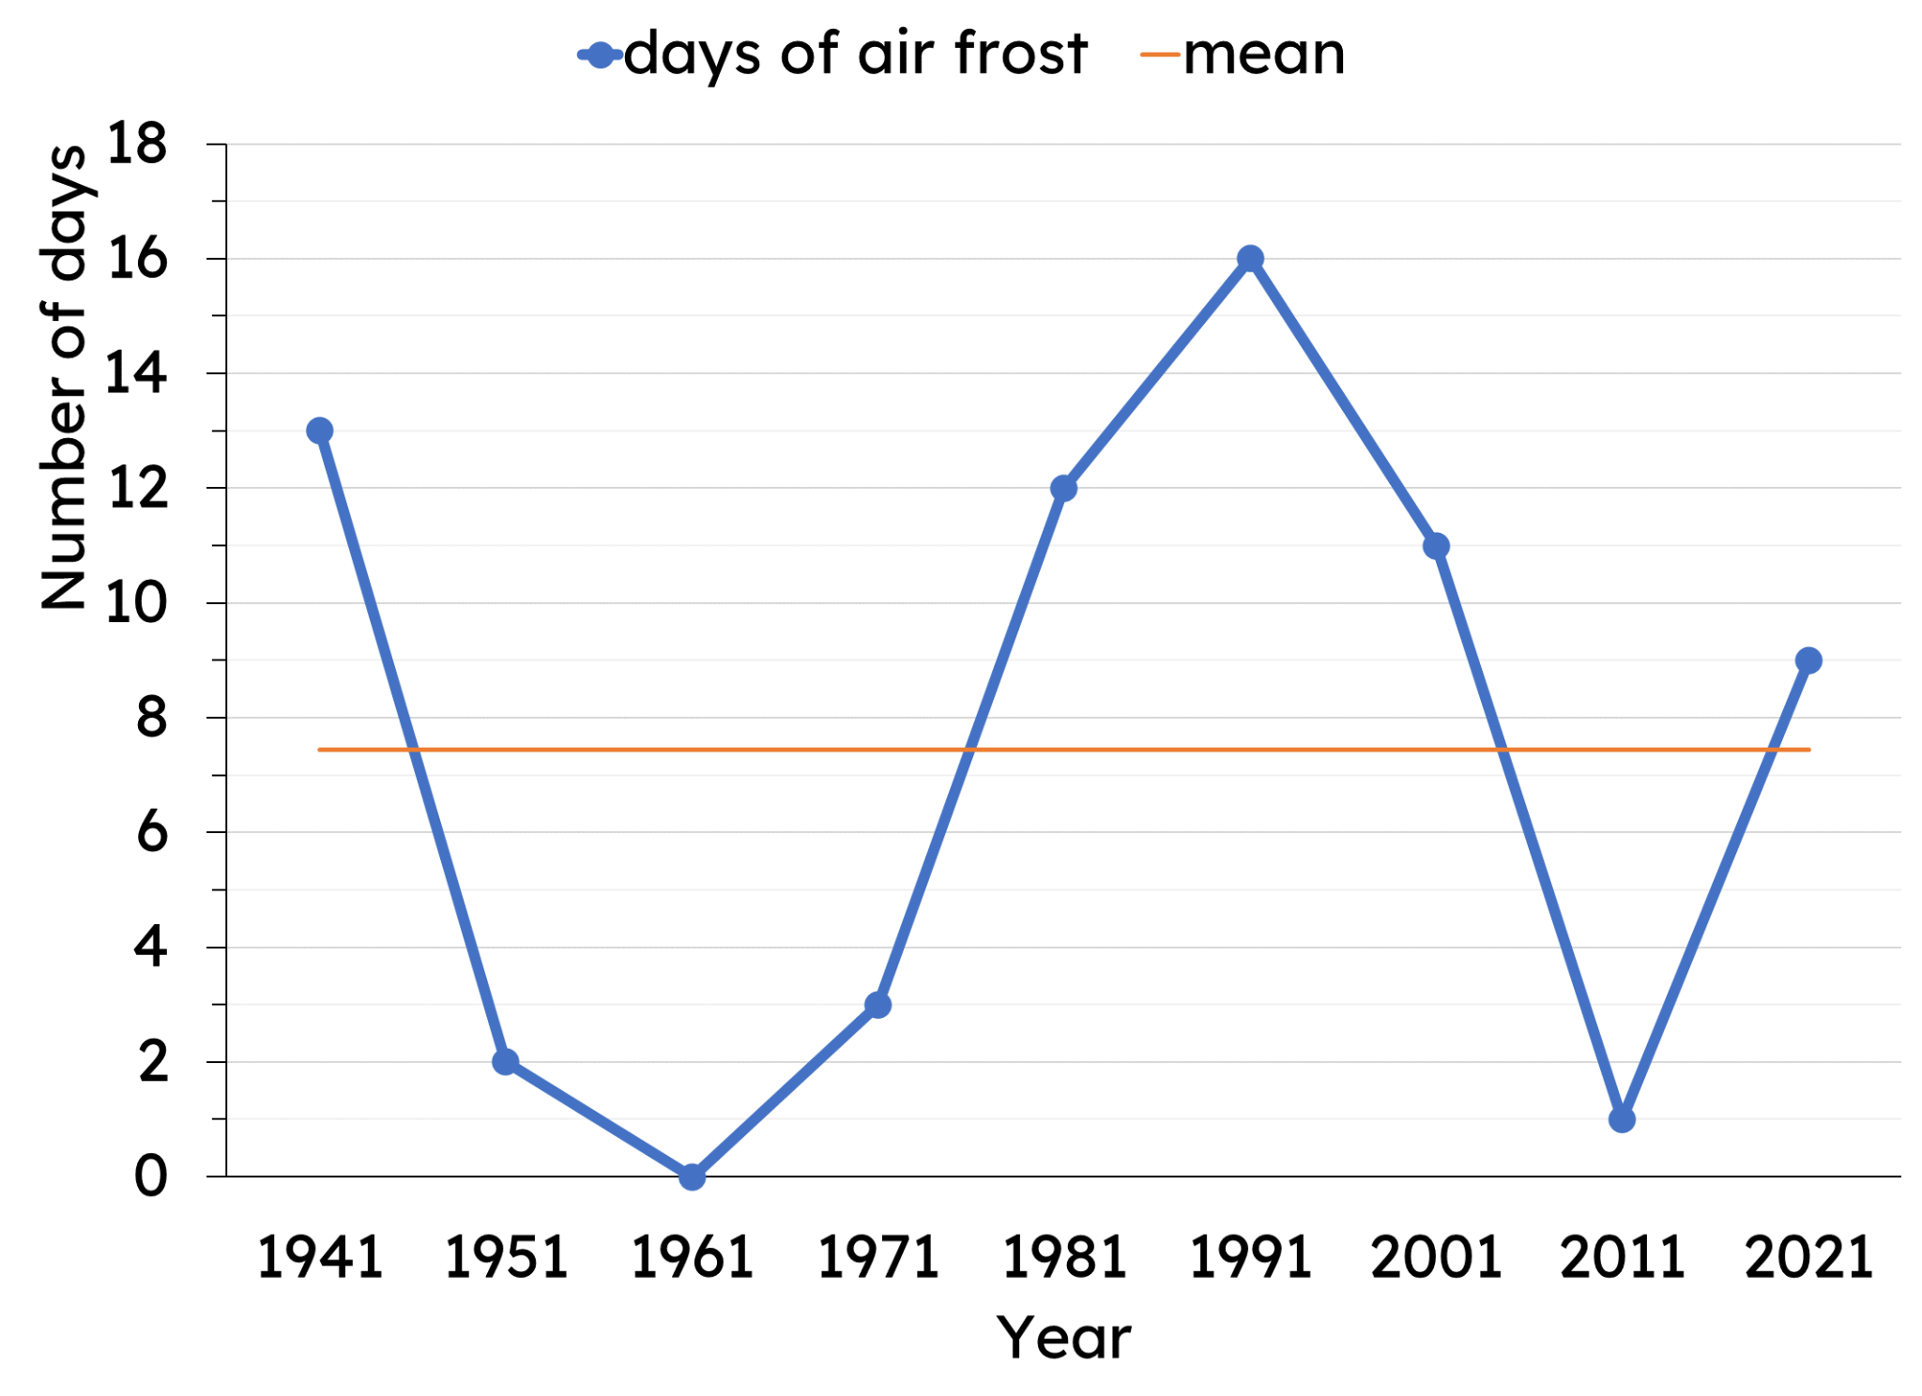
Calculating the mean from a line graph
The same data can be represented as line graph or a time-series graph.
Each point is one of the pieces of data from the data set.
To find the mean, we would need to read each point, add them up and divide by how many points there are.
The line shows the mean value.

Slide 9
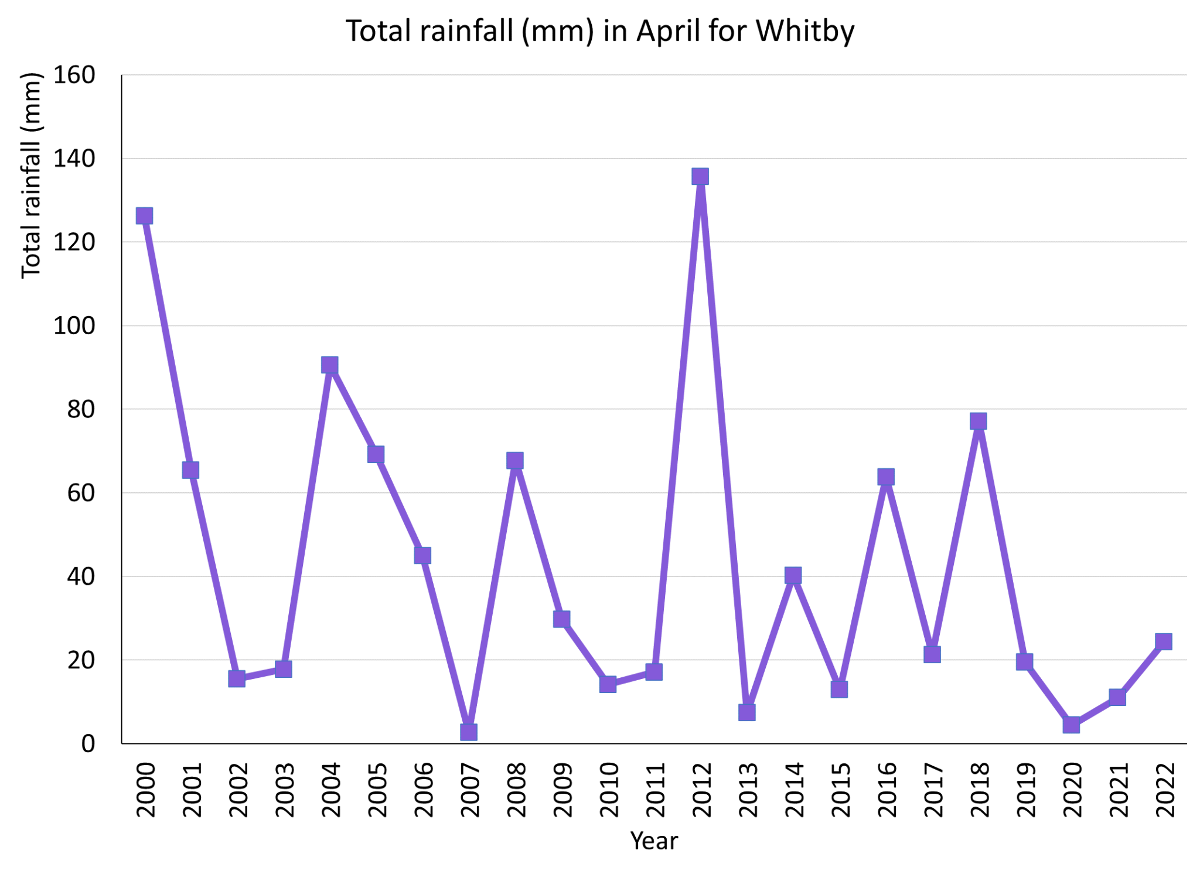
Calculating the mean from a line graph
How much rain was there in April 2014?
40 mm

Slide 10
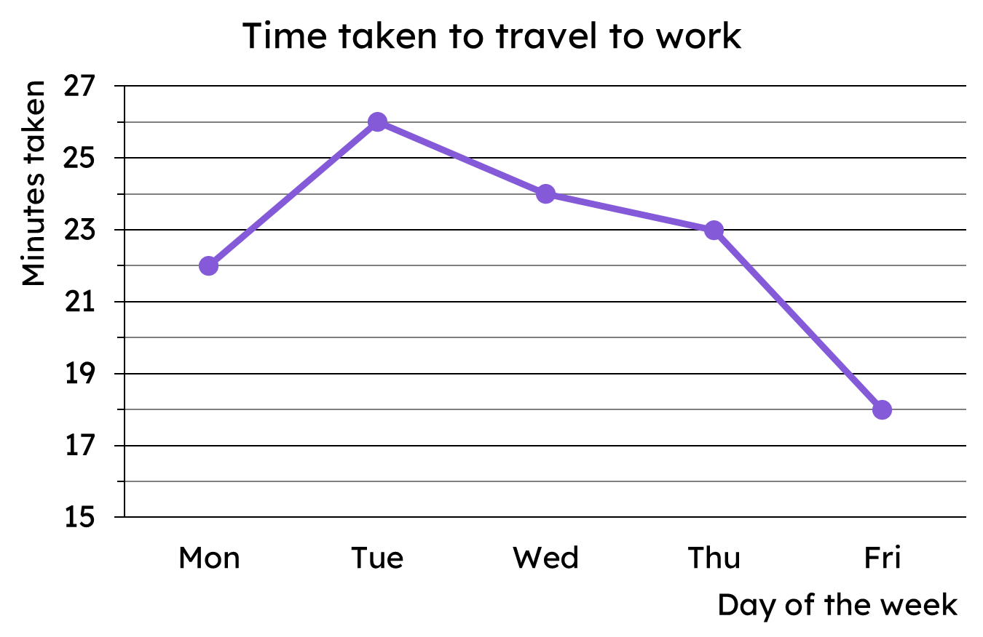
Calculating the mean from a line graph
This line graph shows the time taken for someone to travel to work over the course of 1 week.
To find the mean time taken, we need the total time to then share evenly across the 5 days.

Slide 11
Calculating the mean from a line graph
This line graph shows the time taken for someone to travel to work over the course of 1 week.
Read off the 5 data points to complete the table.
22
Mon
Tue
Wed
Thu
Fri
26
24
23
18

Slide 12
Calculating the mean from a line graph
This line graph shows the time taken for someone to travel to work over the course of 1 week.
To find the mean time taken, we need the total time to then share evenly across the 5 days.
Mon | Tue | Wed | Thu | Fri
22 | 26 | 24 | 23 | 18
Total time taken = 113 minutes
Mean time taken per day
= 113 ÷ 5 = 22.6 minutes per day

Slide 13
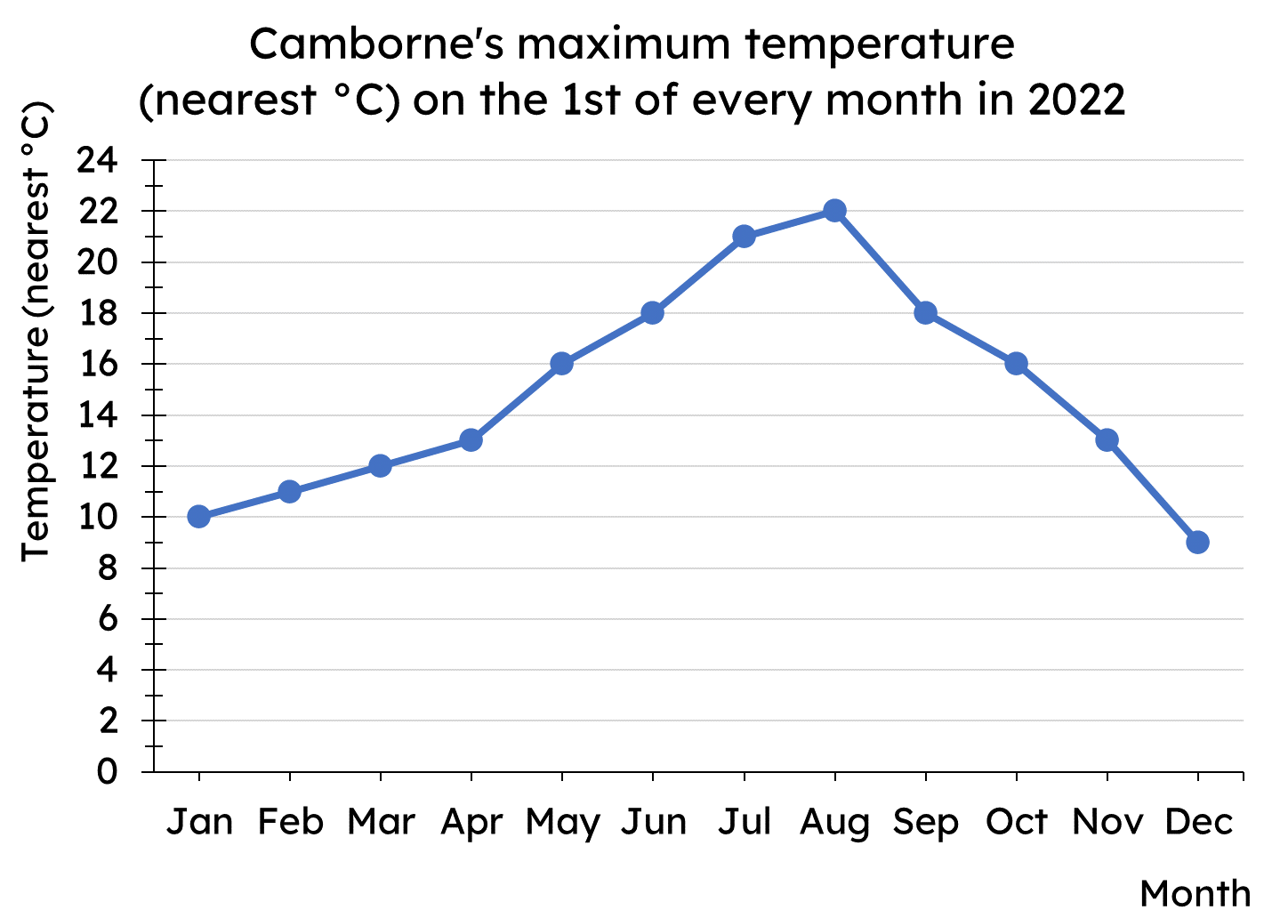
Calculating the mean from a line graph
Use the line graph to complete the table of data.
Jan
Feb
Mar
Apr
May
Jun
Jul
Aug
Sep
Oct
Nov
Dec

Slide 14
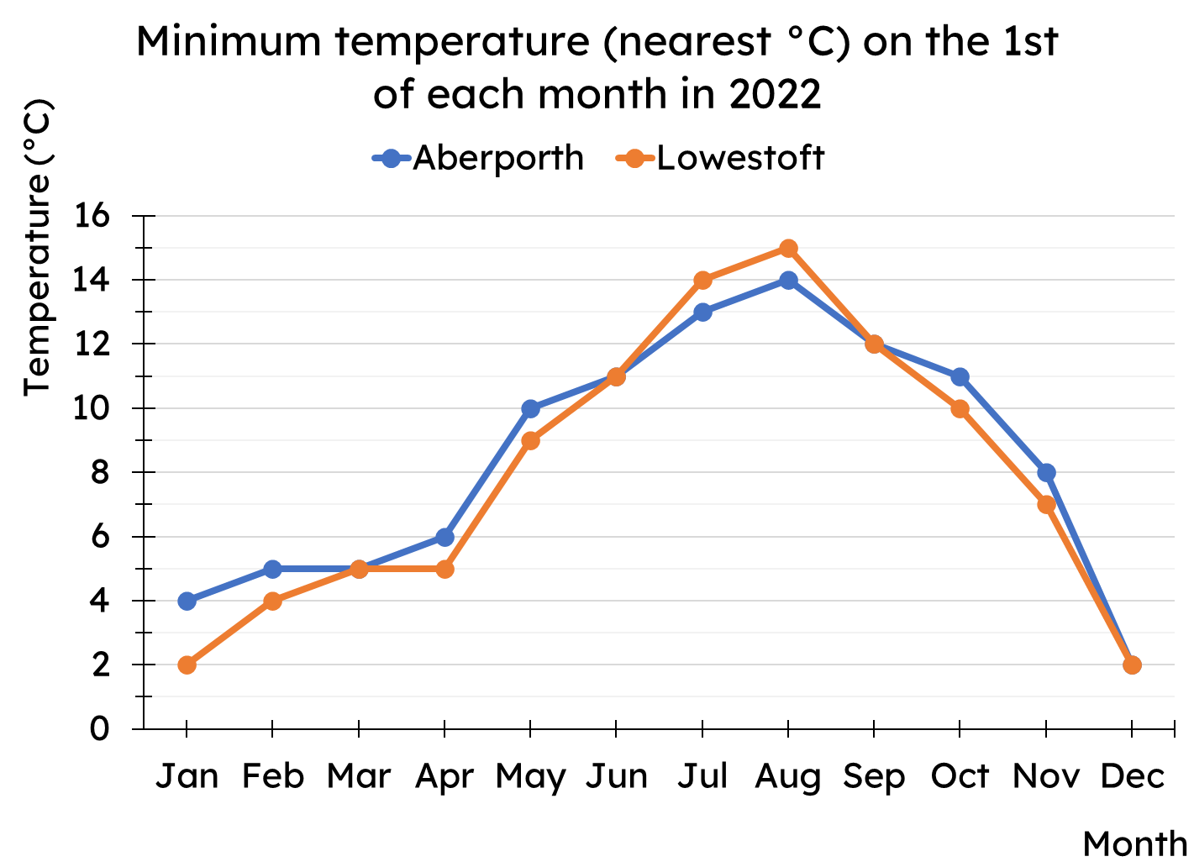
Calculating the mean from a line graph
Calculate the mean of each data set shown on the line graph.

Slide 15
Calculating the mean from a line graph
Jan | 10
Feb | 11
Mar | 12
Apr | 13
May | 16
Jun | 18
Jul | 21
Aug | 22
Sep | 18
Oct | 16
Nov | 13
Dec | 9
Use the line graph to complete the table of data.

Slide 16
Calculating the mean from a line graph
Calculate the mean of each data set shown on the line graph.
Aberporth
Total temperature = 101
Mean minimum temperature = 101 ÷ 12 = 8.42 °C (2dp)
Lowestoft
Total temperature = 96
Mean minimum temperature = 96 ÷ 12 = 8 °C

Slide 17
Calculating the mean
Calculating the mean from a line graph
Calculating the mean from an ungrouped frequency table
Calculating the mean from a bar chart

Slide 18
Calculating the mean from an ungrouped frequency table
Here is a plan view of a restaurant’s tables.
This is a table.
This shows where a person is seated.
This means two people are at the table.

Slide 19
Calculating the mean from an ungrouped frequency table
How many tables are there at this restaurant?
11 tables
How many people are dining at the restaurant?
33 people

Slide 20
Calculating the mean from an ungrouped frequency table
The same information can be shown as a frequency table too.
Group size | Frequency
0
1
1
1
2
2
3
2
4
3
5
2

Slide 21
Calculating the mean from an ungrouped frequency table
Group size | Frequency
0
1
1
1
2
2
3
2
4
3
5
2
We also know there are 33 diners in the restaurant but how can you tell from the frequency table?

Slide 22
Calculating the mean from an ungrouped frequency table
Group size | Frequency
0
1
This represents 3 tables, each with 4 diners.
1
1
2
2
That contributes to 12 to the total diners in the restaurant.
3
2
4
3
This represents 2 tables, each with 5 diners, that contributes to 10 to the total diners in the restaurant.
5
2

Slide 23
Calculating the mean from an ungrouped frequency table
Group size | Frequency | Number of diners
 |  | 0
 |  | 1
 |  | 4
 |  | 6
 |  | 12
 |  | 10
0
✖
1
=
1
✖
1
=
2
✖
2
=
3
✖
2
=
4
✖
3
=
5
✖
2
=
Total number of diners = 33

Slide 24
Calculating the mean from an ungrouped frequency table
The restaurant tables were set up on another day.
How many people were eating in groups of 4?
Group size | Frequency
0 | 0
1 | 1
2 | 4
3 | 2
4 | 3
5 | 1
12 people, as there were 3 tables of 4.

Slide 25
Calculating the mean from an ungrouped frequency table
The restaurant tables were set up on another day.
How many people were eating at the restaurant in total?
Group size | Frequency | Number of diners
0 | 0 | 0
1 | 1 | 1
2 | 4 | 8
3 | 2 | 6
4 | 3 | 12
5 | 1 | 5
32 diners in total

Slide 26
Calculating the mean from an ungrouped frequency table
Group size | Frequency | Number of diners
 |  | 0
 |  | 1
 |  | 4
 |  | 6
 |  | 12
 |  | 10
What is the mean number of diners per table at the restaurant?
0
1
1
1
Total number of diners = 33
2
2
=
Total number of tables = 11
3
2
= 3 diners per table
4
3
5
2
Total number of tables = 11
Total number of diners = 33

Slide 27
Calculating the mean from an ungrouped frequency table
What is the mean number of diners per table at the restaurant?
Total number of diners = 33
=
Total number of tables = 11
= 3 diners per table
The mean tells us the number of diners at each table if they were evenly distributed.

Slide 28


Calculating the mean from an ungrouped frequency table
Which of these mean values seems reasonable for these data?
a
10.7 stars
Star rating | Frequency
1 | 12
2 | 18
3 | 21
4 | 38
5 | 45
The mean should fit within the data.
b
3.5 stars
c
112 stars

Slide 29
Calculating the mean from an ungrouped frequency table
1) A class take a quiz, marked out of 6. The frequency table shows the results for the class.
Quiz score | 0 | 1 | 2 | 3 | 4 | 5 | 6
Frequency | 3 | 4 | 4 | 7 | 10 | 4 | 1
a) How many pupils are in the class?
b) How many marks did the class get as a group?
c) Hence, what is the mean marks per pupil?

Slide 30
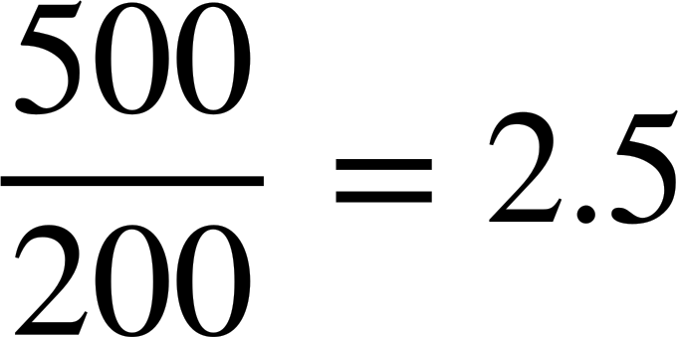
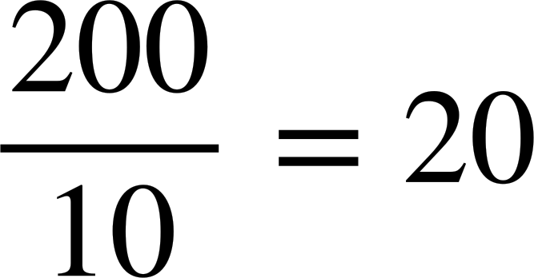
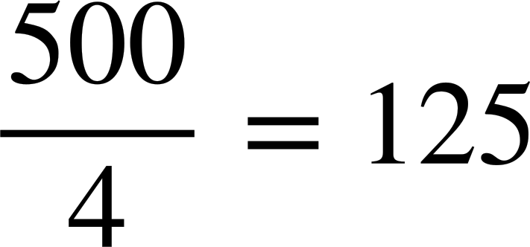
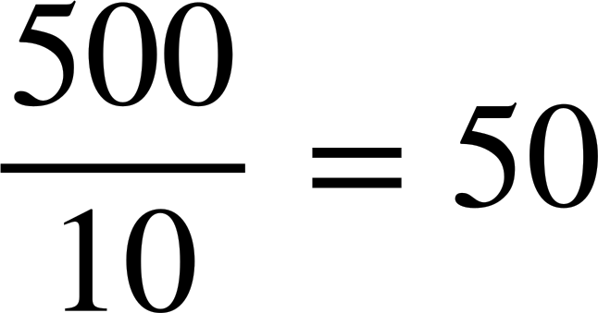
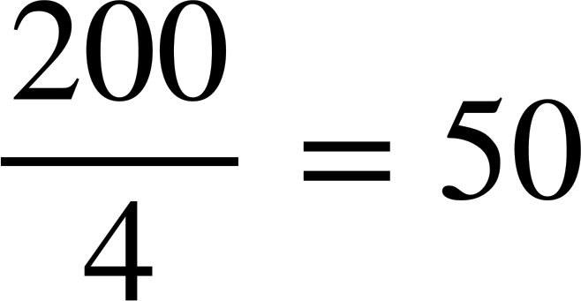
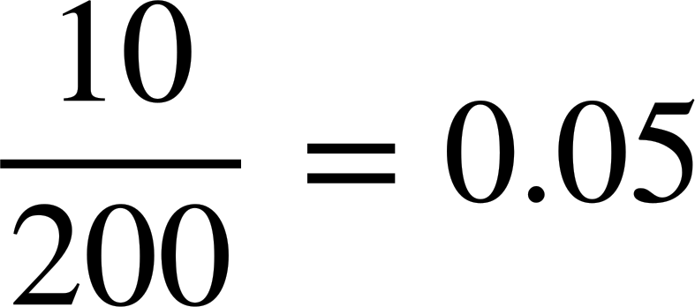
Calculating the mean from an ungrouped frequency table
The frequency table shows the number of bedrooms in different houses within an area of a town.
Which calculation correctly finds the mean for this frequency table? For each incorrect answer, why is it wrong?
Bedrooms | Frequency
1 | 20
2 | 93
3 | 54
4 | 33
a)
b)
c)
d)
e)
f)

Slide 31
Calculating the mean from an ungrouped frequency table
1) A class take a quiz, marked out of 6. The frequency table shows the results for the class.
Quiz score | 0 | 1 | 2 | 3 | 4 | 5 | 6
Frequency | 3 | 4 | 4 | 7 | 10 | 4 | 1
a) How many pupils are in the class?
b) How many marks did the class get as a group?
c) Hence, what is the mean marks per pupil?
3 + 4 + 4 + 7 + 10 + 4 + 1 = 33 pupils
0 + 4 + 8 + 21 + 40 + 20 + 6 = 99 marks
99 ÷ 33 = 3 marks per pupil

Slide 32
Calculating the mean from an ungrouped frequency table
The frequency table shows the number of bedrooms in different houses within an area of a town.
Which calculation correctly finds the mean for this frequency table? For each incorrect answer, why is it wrong?
Bedrooms | Frequency
1 | 20
2 | 93
3 | 54
4 | 33
a)
b)
c)
d)
e)
f)

Slide 33
Calculating the mean from an ungrouped frequency table
The frequency table shows the number of bedrooms in different houses within an area of a town.
Which calculation correctly finds the mean for this frequency table? For each incorrect answer, why is it wrong?
Bedrooms | Frequency
1 | 20
2 | 93
3 | 54
4 | 33
a)
b)
d)
f)
In each of these, the 10 comes from adding up the first column, which is meaningless.

Slide 34
Calculating the mean from an ungrouped frequency table
The frequency table shows the number of bedrooms in different houses within an area of a town.
Which calculation correctly finds the mean for this frequency table? For each incorrect answer, why is it wrong?
Bedrooms | Frequency
1 | 20
2 | 93
3 | 54
4 | 33
a)
c)
e)
And the 4 in these is how many categories, not how many pieces of data.

Slide 35
Calculating the mean
Calculating the mean from a line graph
Calculating the mean from an ungrouped frequency table
Calculating the mean from a bar chart

Slide 36
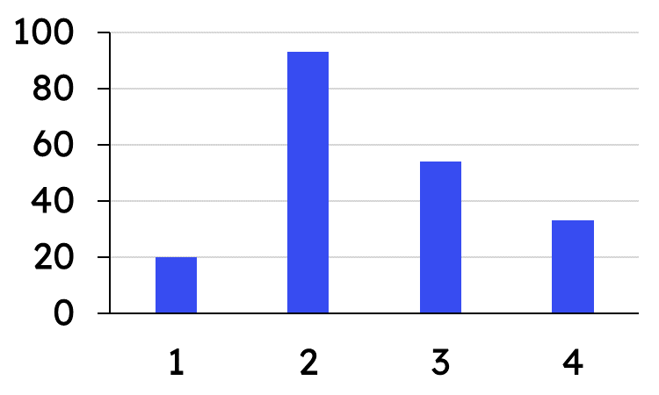
Calculating the mean from a bar chart
Bar charts can show data in different ways.
This chart is showing the number of bedrooms in different houses within an area of a town.
The four bars are representing 200 pieces of data.
Frequency
Bedrooms
We will explore how to find the mean from a bar chart that represents frequency.

Slide 37
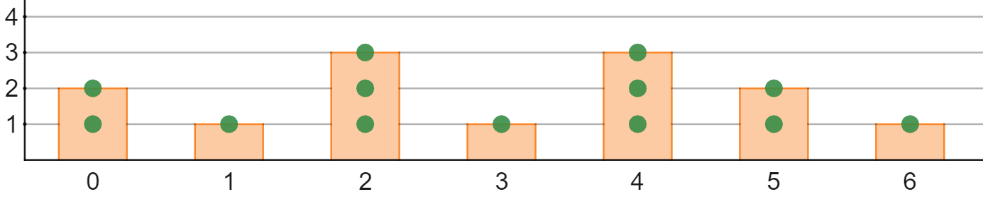
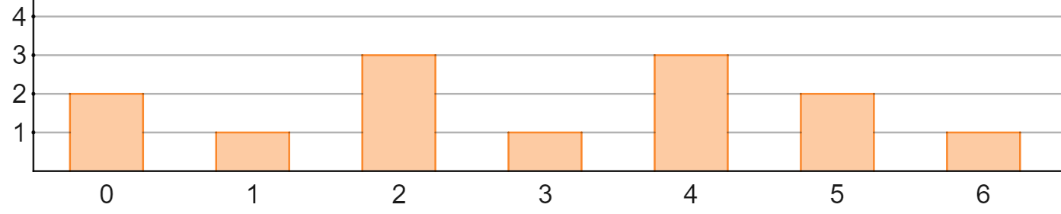


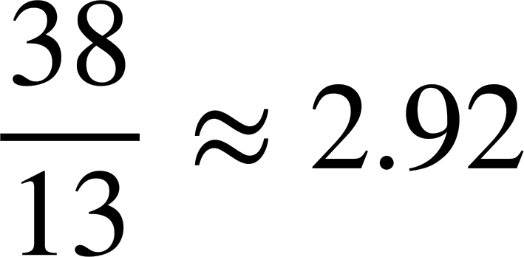
Calculating the mean from a bar chart
Here is a bar chart that shows the number of each table type in a restaurant.
frequency
diners per table
Mean number of diners per table = total diners ÷ number of tables
Total diners =
Number of tables =
Mean number of diners per table =

Slide 38
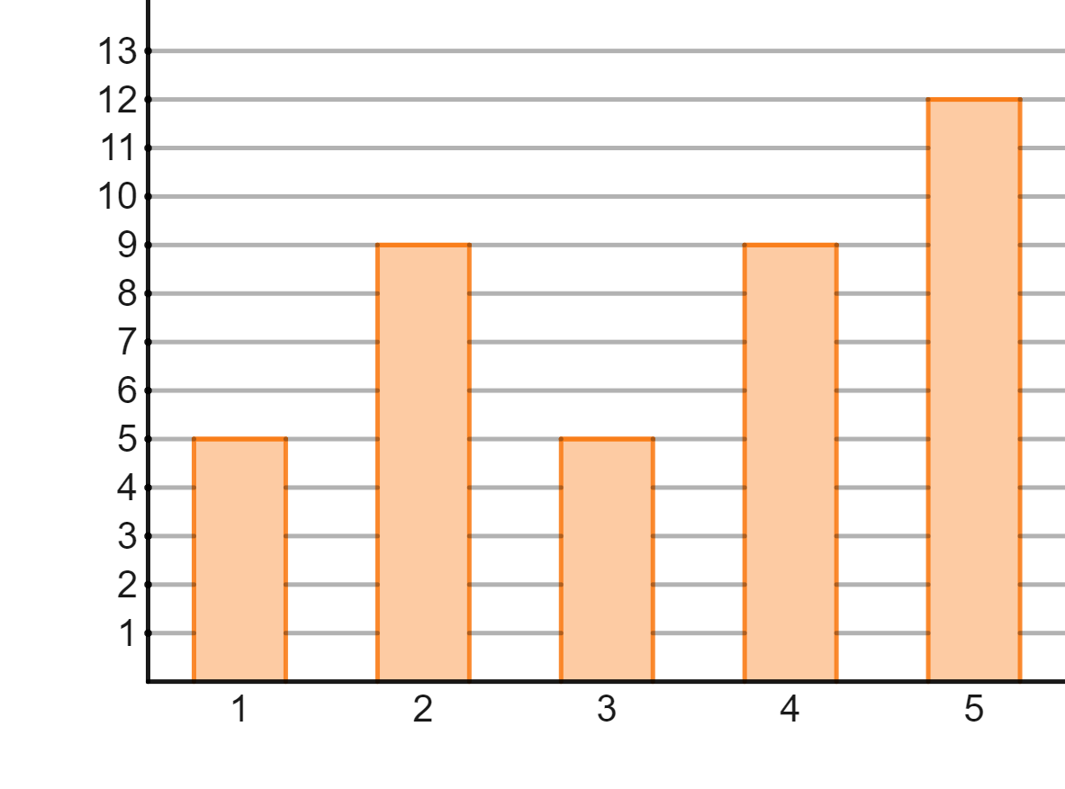
Calculating the mean from a bar chart
This bar chart represents the star rating of a restaurant.
The mean has been calculated as 3.35 stars.
Frequency
Adding the frequencies (heights of the bars) and dividing by 5 (number of bars) gives
40 ÷ 5 = 8
This cannot be the mean star rating.
Star rating

Slide 39
Calculating the mean from a bar chart
To find the mean from a frequency bar chart, you add up the frequencies and divide by the number of bars.
To find calculate the mean, you total the data values and divide by the number of data.
The total frequencies is the number of items within the data, this is the value you divide by when finding the mean.

Slide 40
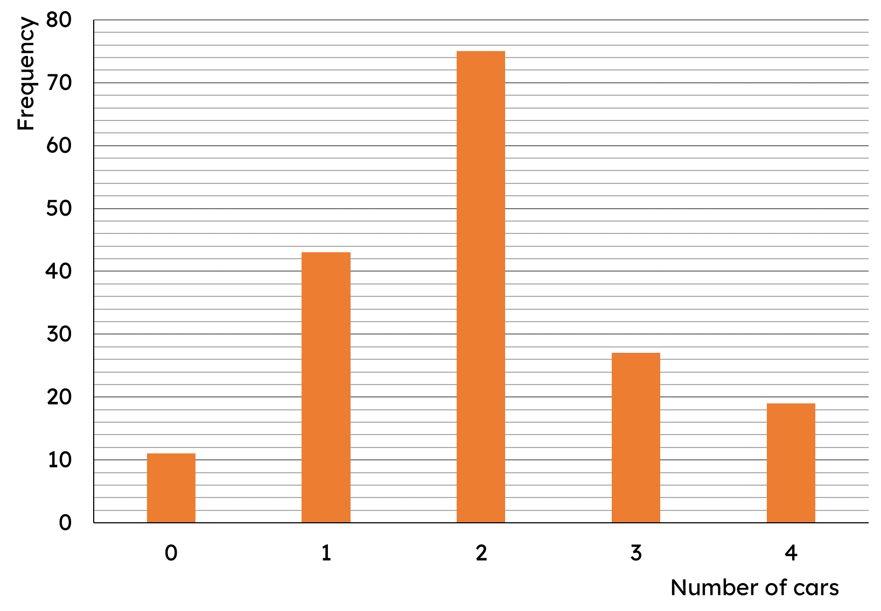
Calculating the mean from a bar chart
This bar chart shows the number of cars per household.
How many households are there?
How many cars are there in total across all households?
What is the mean number of cars per household?

Slide 41
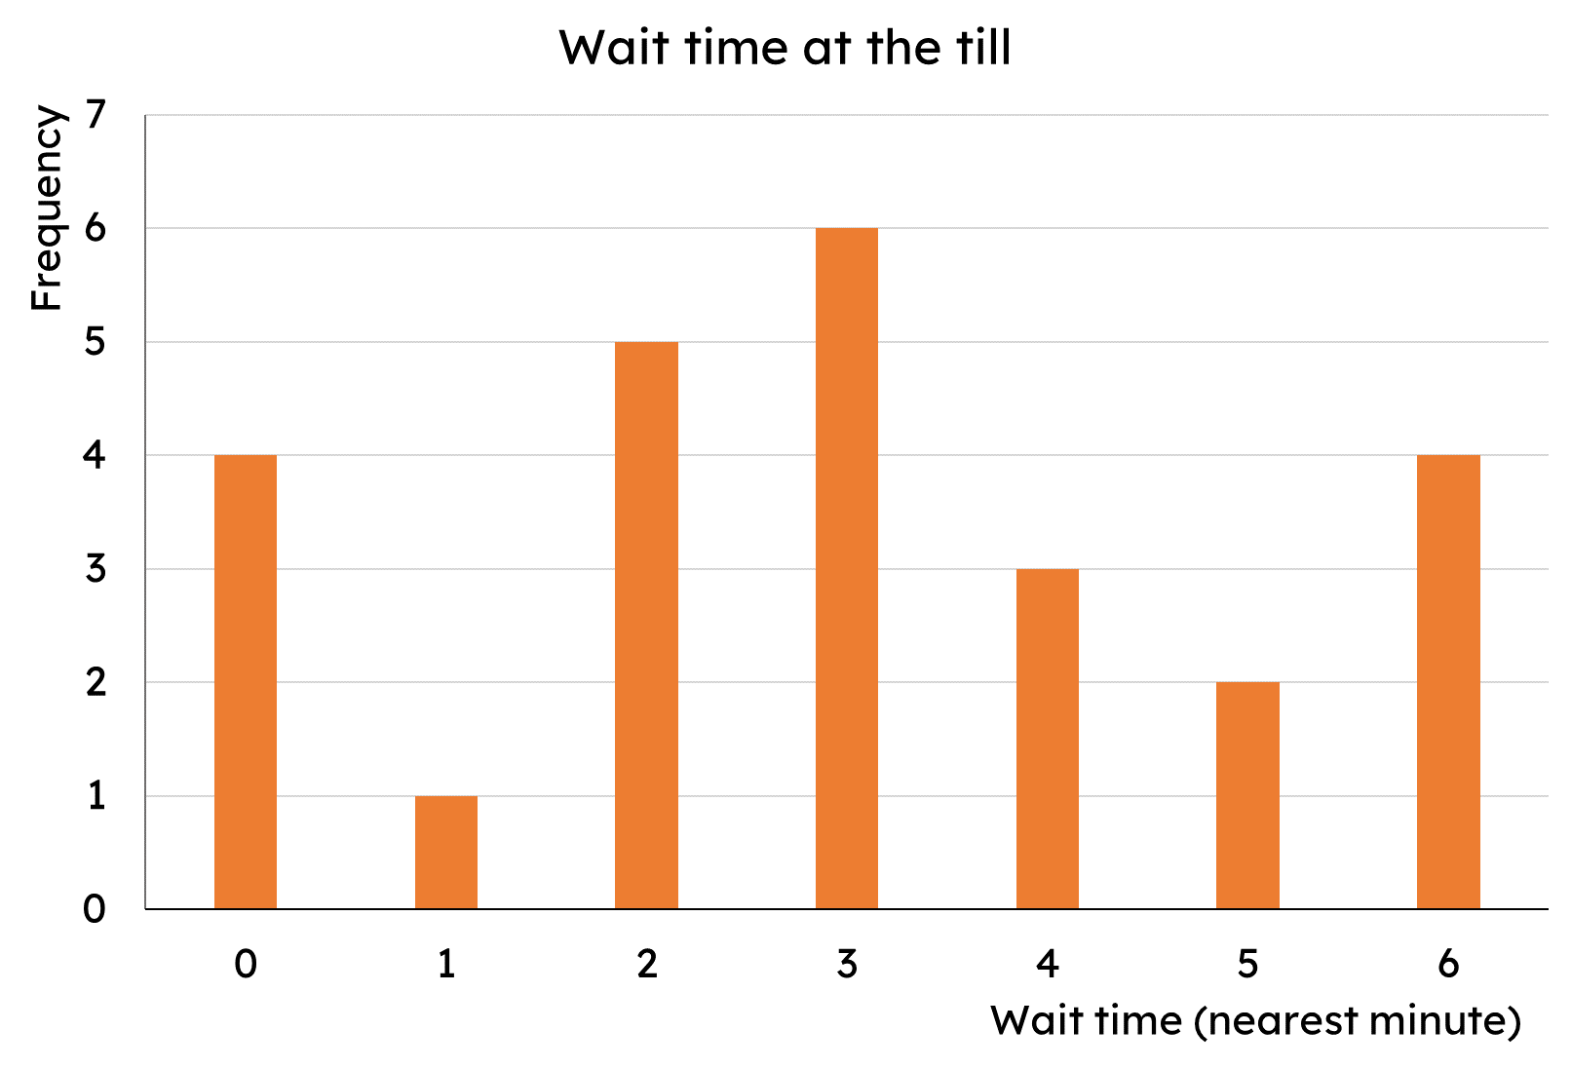
Calculating the mean from a bar chart
2) The bar chart shows the length of time customers spent waiting at a self-service till (to the nearest minute).
What is the mean wait time?

Slide 42
Calculating the mean from a bar chart
This bar chart shows the number of cars per household.
How many households are there?
How many cars are there in total across all households?
What is the mean number of cars per household?
175 households
350 cars
350 ÷ 175 = 2 cars per household

Slide 43
Calculating the mean from a bar chart
2) The bar chart shows the length of time customers spent waiting at a self-service till (to the nearest minute).
What is the mean wait time?
Total time by all customers
= 0 + 1 + 10 + 18 + 12 + 10 + 24
= 75 minutes
Total customers
= 4 + 1 + 5 + 6 + 3 + 2 + 4
= 25 customers
Mean wait time
= 75 ÷ 25 = 3 minutes
6 lots of 3 minutes

Slide 44
Calculating the mean
The mean can be calculated from data presented in various ways.
To find the mean from a line graph, you add up the data points and then divide by the number of points.
To find the mean from a frequency table and bar chart, you need to find the overall total and divide by the total frequency.

Slide 45

© Oak National Academy 2023.
Produced in partnership with Mathematics in Education and Industry.
Licensed on the Open Government Licence v3.0, except where otherwise stated. See Oak terms and conditions.

